Slide 1
SpringSource Product Roadmap
Enterprise Solutions From SpringSource

Slide 2
SpringSource Open Source Projects
Spring Framework
Spring Web Flow
Spring Extensions
Spring Web Services
Spring AOP
Spring Batch
Spring Tool Suite
Spring Java Config
Spring Security
Spring Dynamic Modules OSGi
SpringSource Application Platform

Slide 3
SpringSource Enterprise Products
Support
SpringSource Application Platform E.E.
Spring Batch Enterprise

Slide 4

Spring Open Source Projects:
Spring Framework
New Platform support:
Java 6 (JDK 1.6)‏
Java EE 5
OSGi

Slide 5
Spring Open Source Projects: Spring Framework
Spring 2.5 embraces annotations:
JSR-250 Common Annotations
Spring Autowiring Annotations
Component scanning for autodetection of components
Annotation-driven configuration option
  XML configuration can be combined with annotations or used stand alone
  Different than Spring JavaConfig

Slide 6
Open Source Portfolio:
Spring Web Flow
Dramatically simplifies developing stateful web applications
Easily handles classic problems with the back button, new windows/tabs, session management & cleanup, easily seeing the “flow” of your application, and a lot more
Integrates with everything from Struts to JSF, and even GWT and Flex

Slide 7
Open Source Portfolio:
Spring Extensions
The “kitchen sink” of Spring projects
If it's not in the core framework and not large enough to be a project for itself, look here
Mostly about integration into other projects, such as Drools, Jakarta Commons Validator, etc.

Slide 8
Open Source Portfolio:
Spring Web Services
Allows for easily doing “contract first” web services
  Delivers on the cross-platform, loosely-coupled promise of web services
Provides an abstraction over various Object/XML Mappers as well as the transport mechanism (e.g., synchronous or asynchronous)‏

Slide 9
Open Source Portfolio:
Aspect J and Spring AOP
Aspect-Oriented Programming (AOP) enables modularization of cross-cutting concerns
  To avoid code tangling
  To eliminate scattering
AspectJ
  Original AOP technology (1995)
  Offers a complete AOP language
  Uses byte code modification for aspect weaving
Spring AOP
  Java-based AOP framework with AspectJ integration
  Uses dynamic proxies for aspect weaving

Slide 10
AspectJ and Spring AOP:
AOP-based systems
BankService
CustomerService
ReportingService
Security
Aspect
Transaction
Aspect
Logging
Aspect
Notes:
Need to show weaving here
Tangling
Multiple concerns are considered simultaneously
Implications:
Unclear implementation
Defocusing
Poor quality code
Unintended prioritizing of concerns
Scattering
Same concern is spread over many modules
Implications:
Duplicated code
Inconsistent implementation
Difficult evolution

Slide 11
Open Source Portfolio: Spring Batch
The Spring programming model applied to batch processing
Don’t write code that doesn’t make you money
Download http://www.springframework.org/spring-batch
Application
Batch Core
Batch Infrastructure

Slide 12
Spring Batch:
Job Configuration and Execution
The EndOfDay Job
Job
schedule.date = 2007/05/05
JobParameters
*
The EndOfDay Job
for 2007/05/05
JobInstance
*
The first attempt at
EndOfDay Job
for 2007/05/05
JobExecution
Notes:
Infrastructure: low-level concepts
– Input
– Output
– Retry
– Repeat
Core: boundaries and management information
– Job
– Step
Execution: environment for launching and monitoring jobs

Slide 13
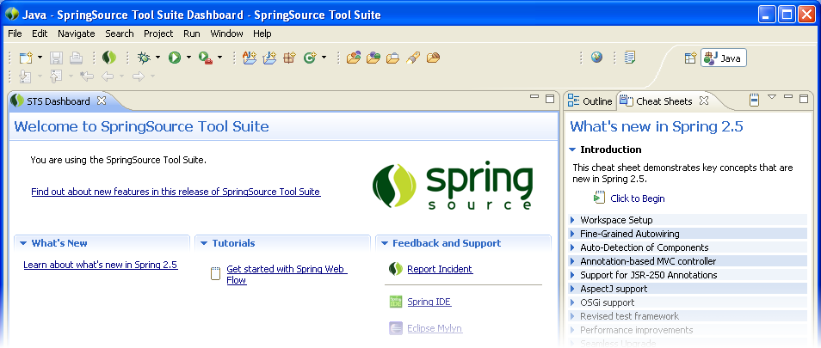
Open Source Portfolio: SpringSource Tool Suite
Cutting edge development capabilities
  task-based workflows
  based on Eclipse Mylyn
Powerful content saves time and helps build better apps
  identifies common errors and suggests fixes
  integrated knowledge base taps expert and community wisdom
  tests unit tracing & recommends best practices
  integrated samples, cheat sheets, code guides
  easier to work on projects with multiple inter-related files
Notes:
29

Slide 14
Open Source Portfolio:
Spring .NET
Spring on the .NET platform
Provides the standard features of Spring (dependency injection, AOP, enterprise abstractions) using the conventions and technologies common in the .NET platform
Notes:
29
29

Slide 15
Open Source Portfolio:
Spring JavaConfig
Gives the same advantages of an externalized configuration that the standard XML support provides, but in Java (no need for FactoryBeans), complete with strong type-checking, improved refactoring support, etc.
Notes:
29
29

Slide 16
Open Source Portfolio:
Spring Security‏
Formerly Acegi Security
Far and away the most powerful and flexible security system available
  Integrates with everything (JAAS, basic auth, smart cards, etc.)‏
  Can secure individual services, objects, web sites, etc in exactly the same way: only the configuration changes
Notes:
29
29

Slide 17
Open Source Portfolio:
Spring Dynamic Modules for OSGi
Provides a simplified abstraction to OSGi, allowing the use of bundles like any other application context
Allows for the dynamic runtime discovery and configuration of services
  Enables the “stackless stack”
Notes:
29
29

Slide 18
Open Source Portfolio:
Spring Integration
Provides a dramatically simplified means of using SOA
  POJO-based – no need to write to a framework
Scales up and down transparently (unlike an ESB, for example)‏
Suited for connecting enterprise applications
  Can be used from within an existing application
  Lightweight (like any Spring application):
    run from JUnit test
    run within webapp
  Focused on integration, not on ESB
Notes:
29
29

Slide 19






Open Source Portfolio:
Spring Integration
Copyright 2008 SpringSource. Copying, publishing or distributing without express written permission is prohibited.
29

Slide 20

Typical ESB
Copyright 2008 SpringSource. Copying, publishing or distributing without express written permission is prohibited.
29

Slide 21
Open Source Portfolio: SpringSource Application Platform
Module-based Java application server designed to run enterprise Java applications and Spring-powered applications
Based on the SpringSource Dynamic Module Kernel™ (dm-Kernel)
The dm-Kernel provides a module-based backbone for the server
  harnesses the power of Spring, Apache Tomcat and OSGi-based technologiesCustom Resolver

Slide 22
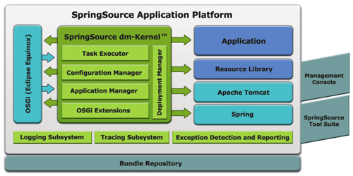
Open Source Portfolio: SpringSource Application Platform
Notes:
29
29

Slide 23
SpringSource Application Platform:
Production Benefits
Real time application and server updates
Better resource utilization
Side by side resource versioning
Longer server uptime
Run new and old web applications

Slide 24
SpringSource Application Platform:
Development Benefits
Faster iterative development
Smaller server footprint
More manageable applications
Greater code reuse

Slide 25
SpringSource Enterprise Products:
Stable, Enterprise-class software
Latest bug fixes
Emergency hot fixes
Patches incorporated in next release
Certified releases
  secure download from SpringSource customer support portal
  production-ready versions only
  certified and warranted to be virus-free, worm-free
  binary upgrades immediately available to all subscribers
Indemnification (gold and platinum support levels)
Notes:
29

Slide 26
SpringSource Enterprise Products:
Stable, Enterprise-class software
Support
SpringSource Application Platform Enterprise Edition
Enterprise Batch
Notes:
29

Slide 27
SpringSource Enterprise Products: Support “from the source”
Development support
  support from the experts who write the code - lead committers on staff
  access to subject matter experts to increase developer productivity and effectiveness
Production support
  fast turnaround bug-fixes and patches
  support directly from the key committers when required
  committers can get bugs committed in next release
Notes:
29

Slide 28
SpringSource Enterprise Products:
SpringSource Application Platform Enterprise Edition
SpringSource Application Platform E.E.
  SpringSource Application Platform
    With instrumented Spring Framework
  SpringSource Performance Suite
    SpringSource Application Management Suite
    SpringSource Tool Suite
    Advance Pack for Oracle Data Base
Notes:
29
29

Slide 29
SpringSource Enterprise Products:
SpringSource Performance Suite
SpringSource Tool Suite
SpringSource Application Management Suite
SpringSource Advanced Pack for Oracle Database
Notes:
29

Slide 30
SpringSource Performance Suite: SpringSource Tool Suite (OSS)
Cutting edge development capabilities
  task-based workflows
  based on Eclipse Mylyn
Powerful content saves time and helps build better apps
  identifies common errors and suggests fixes
  integrated knowledge base taps expert and community wisdom
  tests unit tracing & recommends best practices
  integrated samples, cheat sheets, code guides
  easier to work on projects with multiple inter-related files
Notes:
29

Slide 31
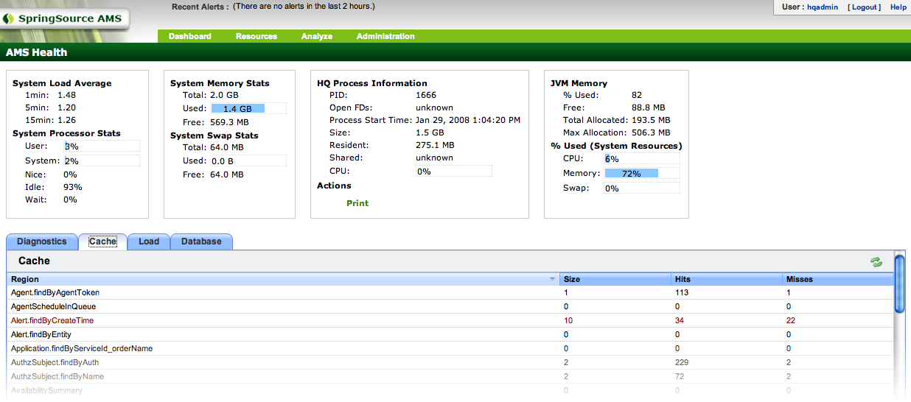
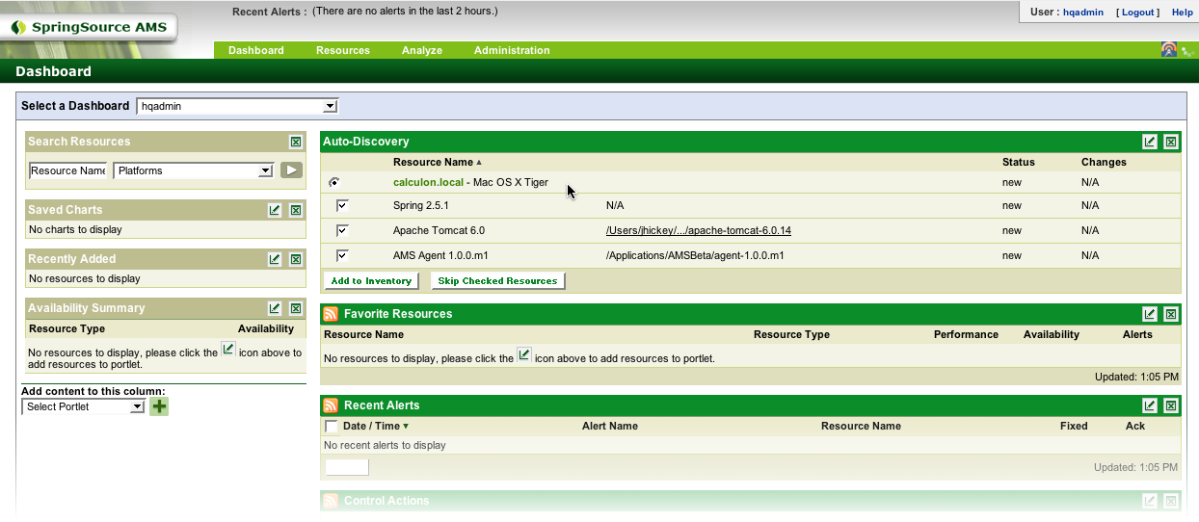
SpringSource Performance Suite: Application Management Suite
Monitor production deployments of spring applications
  supports Tomcat, Weblogic, Websphere & JBoss runtimes
Track application performance, utilization and resource control
  monitor servers, application contexts and bean factories
Define critical application alerts with automated corrective controls
  multi-conditional alert definitions
Control and record configuration changes
Compatible with enterprise wide management tools like Openview & Tivoli
Notes:
29
The SpringSource Application Management Suite (SpringAMS), is included with our Subscriptions, and it allows you to autodiscover, monitor, manage, and control, your spring applications. As an example, you can monitor your application contexts and bean factories – with visibility into their performance and utilization. You can also set up alerts, control resources, record configuration changes, view historical records, and you can even plug it into Openview or Tivoli. It’s a really useful and powerful management solution, that very easy to set up and use.

Slide 32
SpringSource Application Management Suite (AMS)
Auto-Discovery
Monitoring
Alerting and Corrective Control
Enterprise Reporting
Configuration and Log Event Tracking
Metric Base-lining
Integration with Existing Management Tools

Slide 33
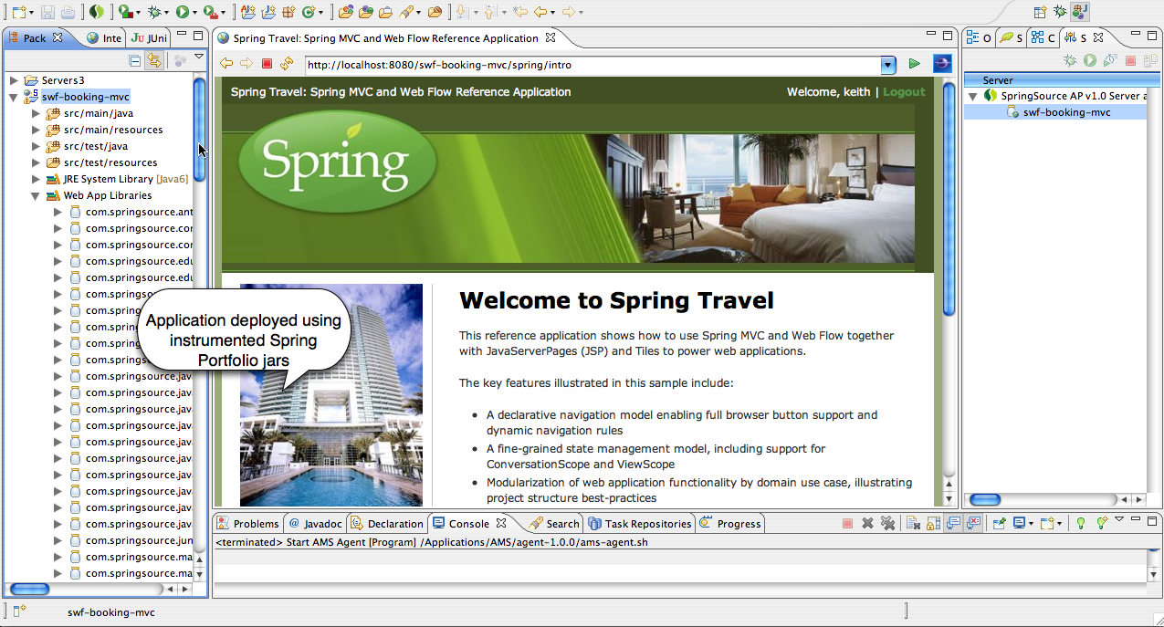
Instrumentation
Deploy your application using Spring jars instrumented for management by compile-time weaving with AspectJ

Slide 34
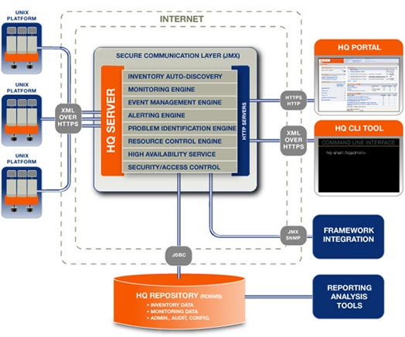
SpringSource AMS Server

Slide 35
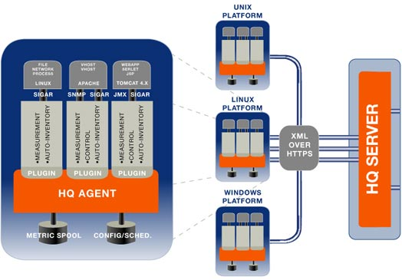
SpringSource AMS Agent

Slide 36
SpringSource Application Management Suite (AMS)
Manage and monitor Spring-powered applications and the platforms and servers they run on
Granular monitoring and control of Spring components
Monitor and control the entire cluster from one easy-to-use dashboard
Bridges the gap between development and operations staff
Find out more at: http://www.springsource.com/products/suite/ams
Notes:
29
29

Slide 37
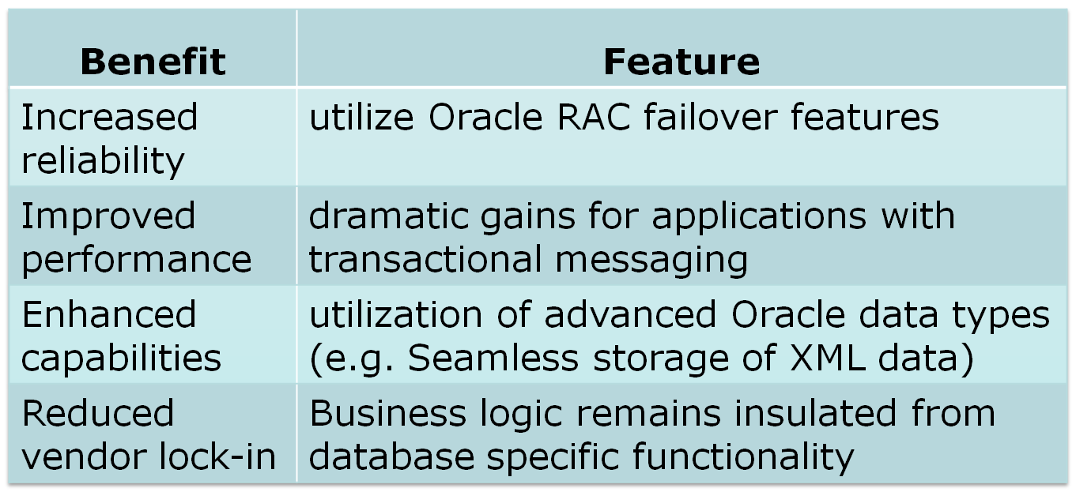
SpringSource Performance Suite:
Advanced Pack for Oracle Database
Notes:
29

Slide 38
SpringSource Enterprise Products:
Spring Batch Enterprise
Coming Soon!
Notes:
29
29

